Slide 1
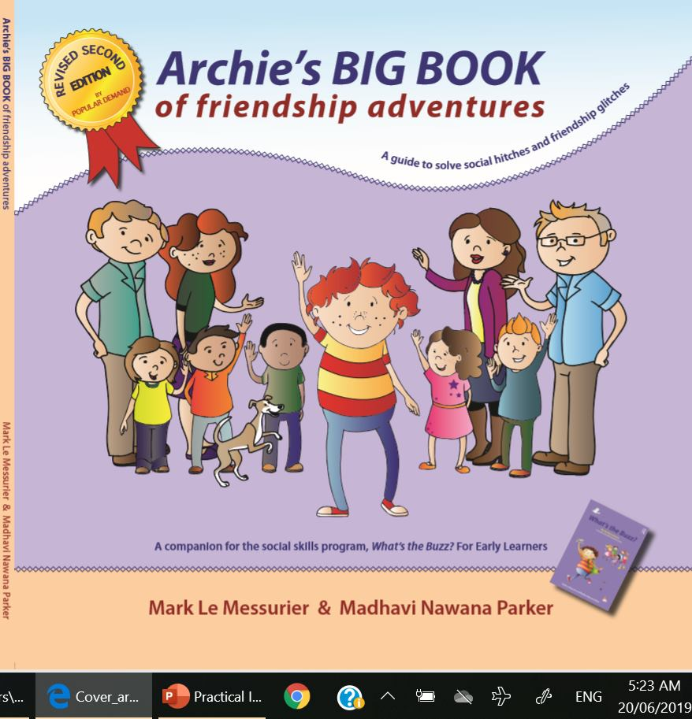
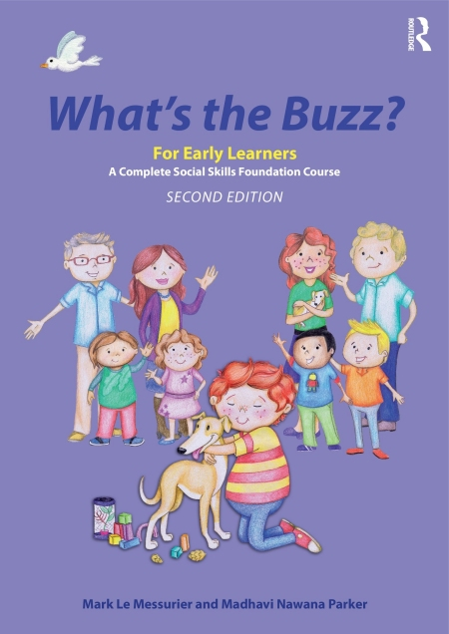
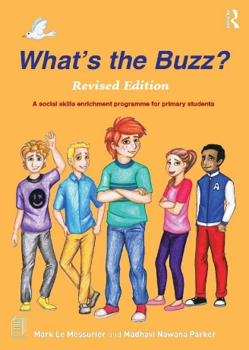
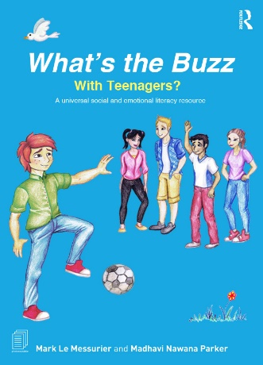
‘Archie’s BIG BOOK of Friendship Adventures’ (Revised Edition, 2023) companions,
What’s the Buzz? For Early Learners
‘What’s the Buzz?’ (2023) –
For Early Learners
SECOND EDITION
‘What’s the Buzz? (2019) –
with TEENAGERS?
‘What’s the Buzz? (2019)–
Revised Edition for PRIMARY Students
The slides and notes can be collected from
www.whatsthebuzz.net.au/main-menu/free-downloads-and-resources
Notes:
NONI
Good morning and a very warm welcome to our first WTB TRAINING for 2026.
Our mission today is to introduce you to each of the 3 ‘What’s the Buzz?’ programs, plus a lot more around POSITIVE EDUCATION and NEUROAFFIRMING PRINCIPLES.
As well, this workshop gives you 6 months of free coaching from us.
So, the conversation that we begin today doesn’t finish at the end of the day.
You can continue for as long as you want a relationship with us.
The one thing that brings us together, is our desire to coach young people with the skills to connect socially, feel emotionally connected and live mentally healthy lives.

Slide 2

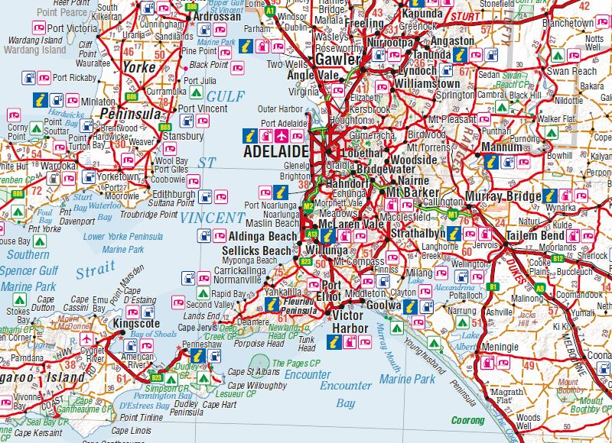

Notes:
MARK and NONI
Now it’s time to learn a little more about you…
Firstly, how far have you travelled to be here today?
Is there anyone who’s home and work is OFF the map on screen?
Okay, who thinks they may have travelled the furthest?

Slide 3

Notes:
MARK and NONI
Next, to learn a little more about you, let’s play a game straight from ‘WTB’
It’s called – “Have you ever?”
To do this, we’ll ask you some questions.
If your answer is “Yes”. We’d like you to ‘stand up’ move away from your seat and sit in an empty seat somewhere else.
If your answer is “No” stay seated.
Are you ready? Feel free to pop your masks on while playing if you want.
Have you ever …
… had experience teaching ‘What’s the Buzz?’?
… been a teacher or leader in a school?
… been a school support officer?
… been a wellbeing leader?
… worked in private practice or do you intend to?
… been a speechie, an OT, counsellor, youth or social worker?
… had a pet?
… kissed your pet?
… let your bed sleep with you at night?
… thought about implementing WTB in your situation?
… drank more than 4 coffees per day?
… had a special or quirky talent?
You may return to your seats.

Slide 4

It’s fantastic to think that in any moment - like right now - literally, 100’s and 100’s of kids, teens or adults are immersed, in some way, in WTB, globally.
Notes:
NONI
‘What’s the Buzz?’ is now being used with children and adolescents in 140 countries.
It has been THE QUIET ACHEIVER – it’s become global and is considered the gold standard approach.
So, today is an opportunity to;
Understand the depth of social and emotional literacy.
What it looks and feels like.
And, how it can become a protective factor for the mental health of children and young people
And, finally, today is an opportunity to discover how you might use the program to enhance your situation.

Slide 5

All the PowerPoints and notes from today are available from www.whatsthebuzz.net.au
To find them go to ‘Free Downloads’
Housekeeping
Notes:
NONI
A little housekeeping first.
We want a thoroughly interactive day, so if you get the urge jump in; ask questions, seek clarification, share and contribute.
We’ve planned for two breaks today…
Morning break at 10.45am for 30 mins
Then, Lunch at 1pm for 45 mins
Tea and coffee are available all day at the back of the room. Please help yourselves at any time.
There are also jugs of water there too. Feel free to replace your tables anytime you want.
Just leave the empty on the table at the back and grab a full one. Toilets are out the big double doors at the back and to the RIGHT. At break times you are welcome to wander the grounds.
We just ask you keep an eye on the time as we do start back up on schedule. There’s hand sanitizer on each table as well as back where you signed in.
Please help yourselves. Elissa would’ve got you to use the QR code to sign in when you arrived but if you haven’t, please pop over to her and do so. Those who indicated special dietary requirements, please find Elissa when it’s break times.
She’ll have your meals for you and names to tick off. Book are available for purchase all day at the back where Elissa signed you in.
Please feel free to have a look at anytime and you’re welcome to take them with you today if you do purchase any.

Slide 6
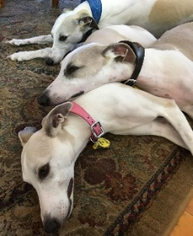
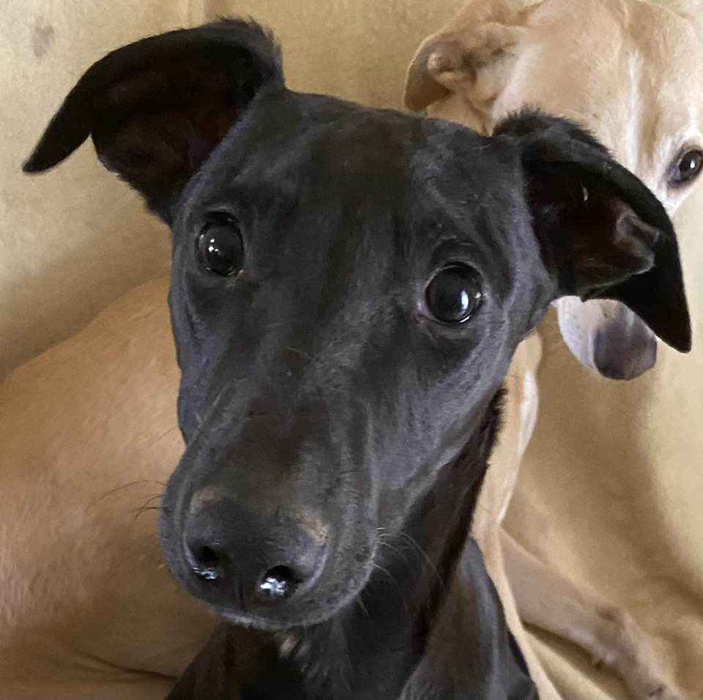
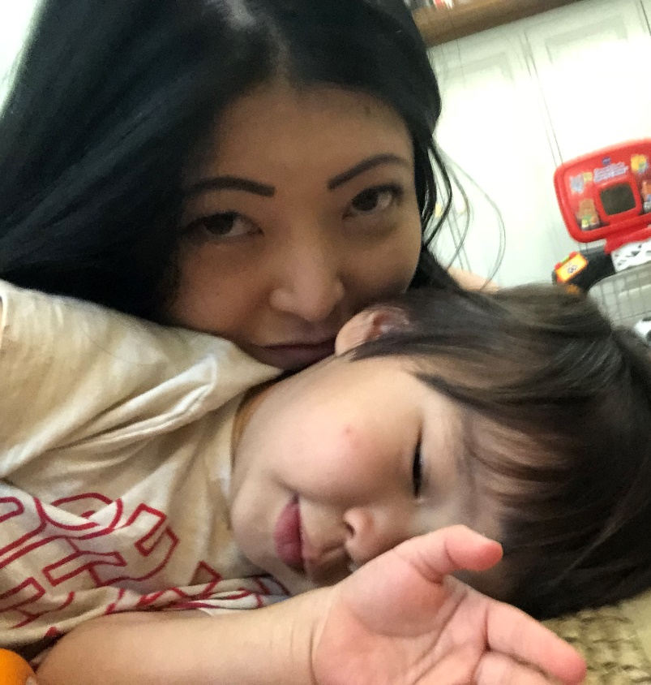
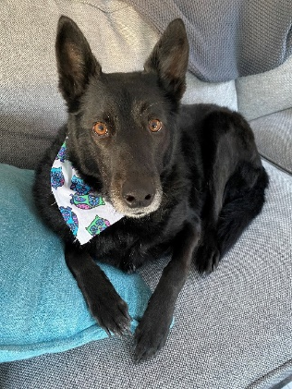
Mark’s publications:
• Cognitive Behavioural Training (2004) • Reflections on Dyslexia (2006) • Parenting Tough Kids (2006 and reprinted many times to 2018) • Stop and Think Friendship DVD Package (2009) with Lindy • ADHD and Specific Learning Difficulties as Companions (2009)
• Teaching Tough Kids (2012)
• What's the Buzz? for Primary Students (2011) with Madhavi • Raising Beaut Kids (2014)
• What's the Buzz? For Early Learners (2015) with Madhavi
• Nurturing Young Minds: Chapter 17 - Dyslexia and Learning Difficulties (2018) • Archie's BIG BOOK of Friendship adventures (2015 and 2019) with Madhavi
• What's the Buzz with Teenagers? (2019) with Madhavi • What's the Buzz? for Primary Students (revised edition, 2019) with Madhavi
• TEACHING VALUES of BEING HUMAN: an education of the mind and the heart (2021)
• Set of 10 AUDIO BOOKS – www.marklemessurier.com.au (2021)
• Guiding Kids through the Tough Moments: Techniques to build a space where children can thrive (2023)
Notes:
NONI to introduce Mark
There’s probably not much I can tell you about my dad that you don’t already know.
It’s been an honour being mentored by him as I’ve developed my practice and become more and more involved in ‘What’s the Buzz?’.
Being able to have someone that I can talk to about any aspect of my work, problems, queries, triumphs…is pretty special.
While I’d like to believe I’m his favourite in the family, I know I’m fighting a losing battle with the 3 whippets that mum and dad have at home.
Yes, they lost Maxi late last year.
I also lost my dog Gryff and feel lost without him!
Dad’s other love in his life has been writing, and you can see this from the books on screen.
In 2022 he became the recipient of ‘Senior South Australian of the Year’.
That means he’s now the oldest person in South Australia!
CLICK

Slide 7
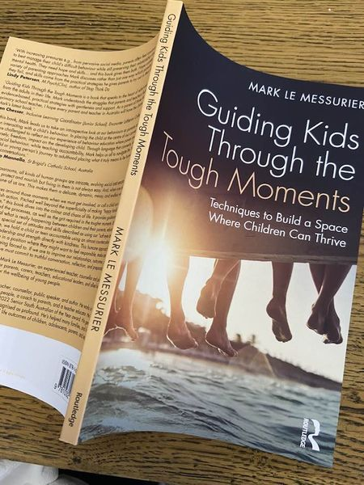
Notes:
NONI
Dad has a new book called, ‘Guiding Kids through the Tough Moments’.
It’s for educators, parents and allied health professionals.
And just as the title suggests – there’s an art to how we handle ourselves in the tough moments at school and at home with kids.
And what we model, impacts hugely on how children and teens manage their feelings and behaviour.
He’s brought some along. Feel free to browse and buy.

Slide 8
Mark’s publications:
• Cognitive Behavioural Training (2004) • Reflections on Dyslexia (2006) • Parenting Tough Kids (2006 and reprinted many times to 2018) • Stop and Think Friendship DVD Package (2009) with Lindy • ADHD and Specific Learning Difficulties as Companions (2009)
• Teaching Tough Kids (2012)
• What's the Buzz? for Primary Students (2011) with Madhavi • Raising Beaut Kids (2014)
• What's the Buzz? For Early Learners (2015) with Madhavi
• Nurturing Young Minds: Chapter 17 - Dyslexia and Learning Difficulties (2018) • Archie's BIG BOOK of Friendship adventures (2015 and 2019) with Madhavi
• What's the Buzz with Teenagers? (2019) with Madhavi • What's the Buzz? for Primary Students (revised edition, 2019) with Madhavi
• TEACHING VALUES of BEING HUMAN: an education of the mind and the heart (2021)
• Set of 10 AUDIO BOOKS – www.marklemessurier.com.au (2021)
• Guiding Kids through the Tough Moments: Techniques to build a space where children can thrive (2023)
Notes:
MARK to introduce Noni
Before I introduce Noni, I must acknowledge my dear friend and co-author of ‘What’s the Buzz? - Madhavi Nawana Parker.
We met many years ago and it was apparent from ‘the get go’ we had a shared understanding about children and young people with brilliant DIVERSE ABILITIES.
The rest is a delightful history!
This is Noni.
She is my daughter, and you are adopted!
In all honesty I’m so pleased she’s graced our lives.
And, Elissa ….
Noni runs her own practice counselling children and teenagers and we share the same room at Wayville.
She’s my co-facilitator for all for my 5 ‘What’s the Buzz?’ groups each week and I love working with her.
In addition, she runs an additional 12 groups, with 6 of these being older TEENS and young adults.
I’m really proud of Noni because she’s created an authentic ‘What’s the Buzz?’ community model. This is a world first!
The truth is, that her older BUZZ clients just won’t leave. They keep returning week after week, year after year. Some have been together for 6 years.
They look forward to connecting and doing all kinds of things together every week.
Noni has developed a real expertise in working with teens and young adults – be sure to pick her brains!
By the way, Noni does have a serious love interest and his name is Gryff.
You can see him in the picture on screen … continue…..

Slide 9
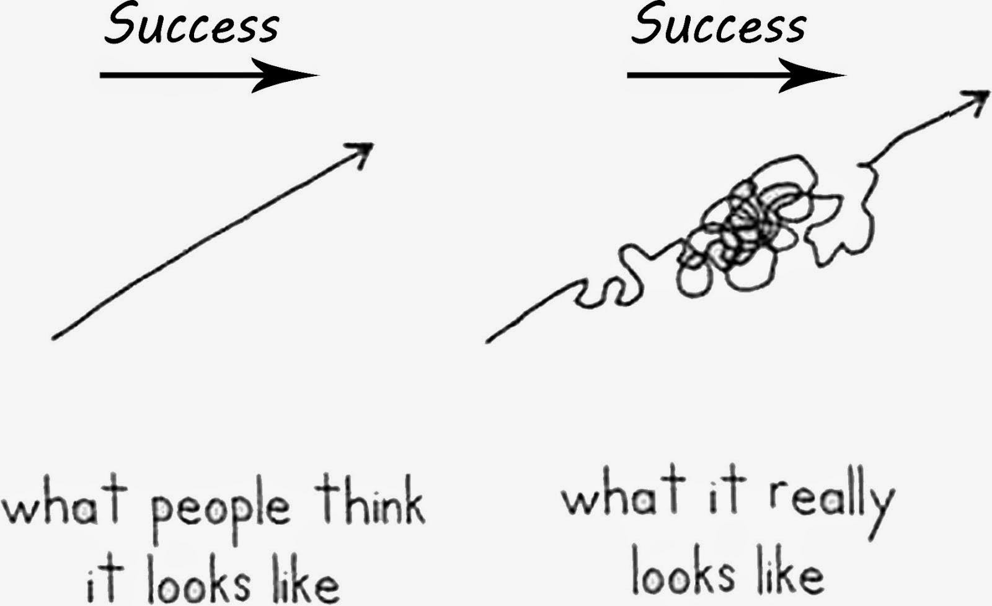
THANK YOU!
Notes:
MARK
I’d like to frame the day!
It is a privilege to be with you.
In your own way and using your own style, you give hope to children, and to families, each day without fanfare.
You persistently strive to build people up; to upskill them and to improve lives.
Please, never lose sight of the wonderful things you do.
There are not enough of you.
You turn up each day with THAT smile on your face.
You switch on your kindness and emotional steadiness for everyone, even when you’re not feeling too emotionally steady yourself.
You appreciate the tricky lives many of the kids and young adults around you are challenged by.
You know that many of your students or clients (and their parents) thrive on your generosity, because they struggle with life.
Thank you for what you do!

Slide 10

Notes:
MARK
Almost 40 years ago, the UN adopted the ‘Convention on the Rights of the Child’.
This was the first time in history, that all children were acknowledged with the right to have a long, safe and loving, CHILDHOOD because in this space, children thrive.
We’ve known that for 40 years.

Slide 11

“I’ve never told your dad I love him.
Mad isn’t it really? I’ve never kissed him.
I’ve returned a hug, but I’ve never offered one.
It’s because of my age, and I suppose my background. All men were buttoned up like that in the old days.
Me and your dad were the same for years, decades.
And now, suddenly, you have to be open and emotionally intelligent.”
Jim reflects as he speaks with his granddaughter in the TV series, Breeders.
Notes:
MARK
Suddenly, a new focus about how children should grow socially, emotionally, intellectually, even spiritually emerged.
The pressure to connect with children, and how to build their emotional intelligence started to grow.
This is still emerging in progressive schools.

Slide 12

Notes:
MARK
Yet, despite, such understandings, today in South Australia we have more children struggling with more complex emotional and behavioural needs, at younger ages, than ever before. Why?

Slide 13

References :
‘The Anxious Generation’ by Jonathan Haidt (2024)
Gabor Mate: The Childhood Lie That’s Ruining All Of Our Lives
https://www.youtube.com/watch?v=uPup-1pDepY
Notes:
We know the answer.
It is a unique combination of negative environmental stressors we have put into the lives of children.
Our kids have walked into this; they are the victims.
These negative stress factors come to them in a way never previously experienced.
They range from families trying to keep away from menacing and destructive distractions, to keeping up with increasing - financial, emotional, and social - pressures.
There’s also the inescapable draw to a multitude of digital platforms for children and their parents. Yes, parents too!
<<<<<<<<<<<<<<<<<<<<<<<<< CONTINUE >>>>>>>>>>>>>>>>>>>>>>>>>>>>>>
Social media carries a unique licence; it can transmit the truth and lies about others, it allows others to transmit truth and lies about us, instantly, all the time, without consent and often without much accountability.
There’s no escaping from being plugged into the judgement of others.
And for many, these stress factors play into the formation of dysfunctional family habits, routines, and communication patterns.
Not only does it impact on the mental health of young people, but is often an trigger for the tricky, anxious, righteous, reactive, and turbulent behaviour we see in kids.
This is a timely reminder that the lives of children are entirely shaped by the dynamics playing out in their environments. And these influences come at a time when our children’s brains are wiring up, vulnerable and susceptible.
And you must experience these shock-waves because you do not work in a vacuum. This is the reason why your work is increasingly complex, will never be done, and will always be in progress.
I want to validate these changes because they are real.
It is a moving reminder that - “our kids have never needed us as much.”

Slide 14

Notes:
MARK
For too long neurodivergence was defined by the stigma of deficits, disorders, disability, limitations and being broken.
Today, science and the neurodiversity movement is revolutionising the way we think about, discuss, and offer supports people on the neurodiverse spectrum.
We now describe ADHD, Autism, anxiety, dyslexia, dyspraxia, dyscalculia, dysgraphia, just to mention a few, under the neurodivergent umbrella.
We now know through brain imaging that the ‘emotional and behavioural differences’ are the DIRECT RESULT of ‘physical differences’ in brain structures and brain function.
Yes, each of us are completely shaped by our neurology!
So, no amount of our frustration, disapproval, or threats can change a person’s neurobiology.

Slide 15
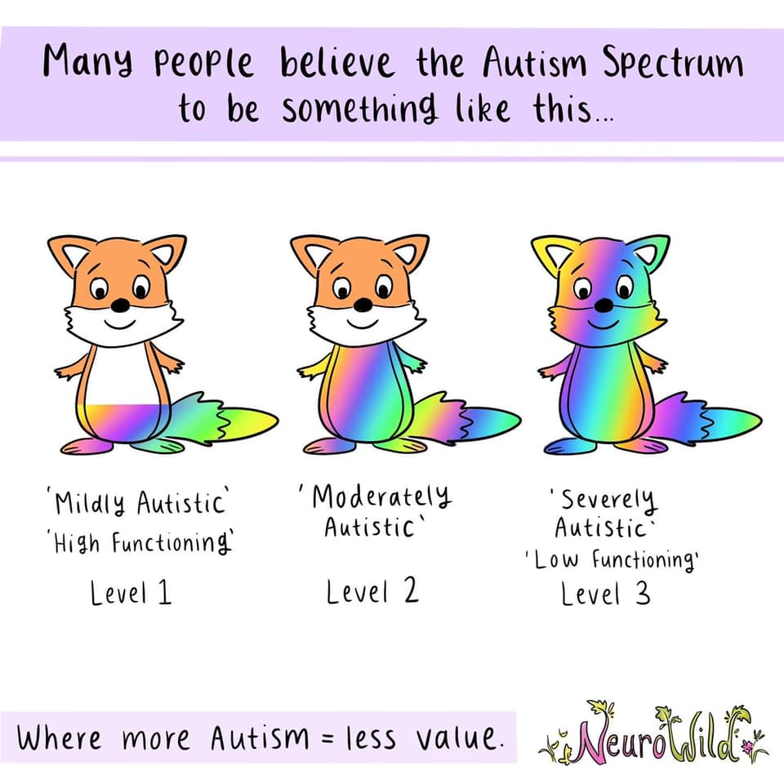
Notes:
MARK
Interestingly, we never say to each other, “Hey? How neurotypical are you?”
Yet my Autistic clients are often asked, “How Autistic are you - level 1, 2 or 3?”
They don’t like it.
And nor should they.
It is the height of ignorance.
It ignores all the learning gained from understanding the DOUBLE EMPATHY PROBLEM.

Slide 16
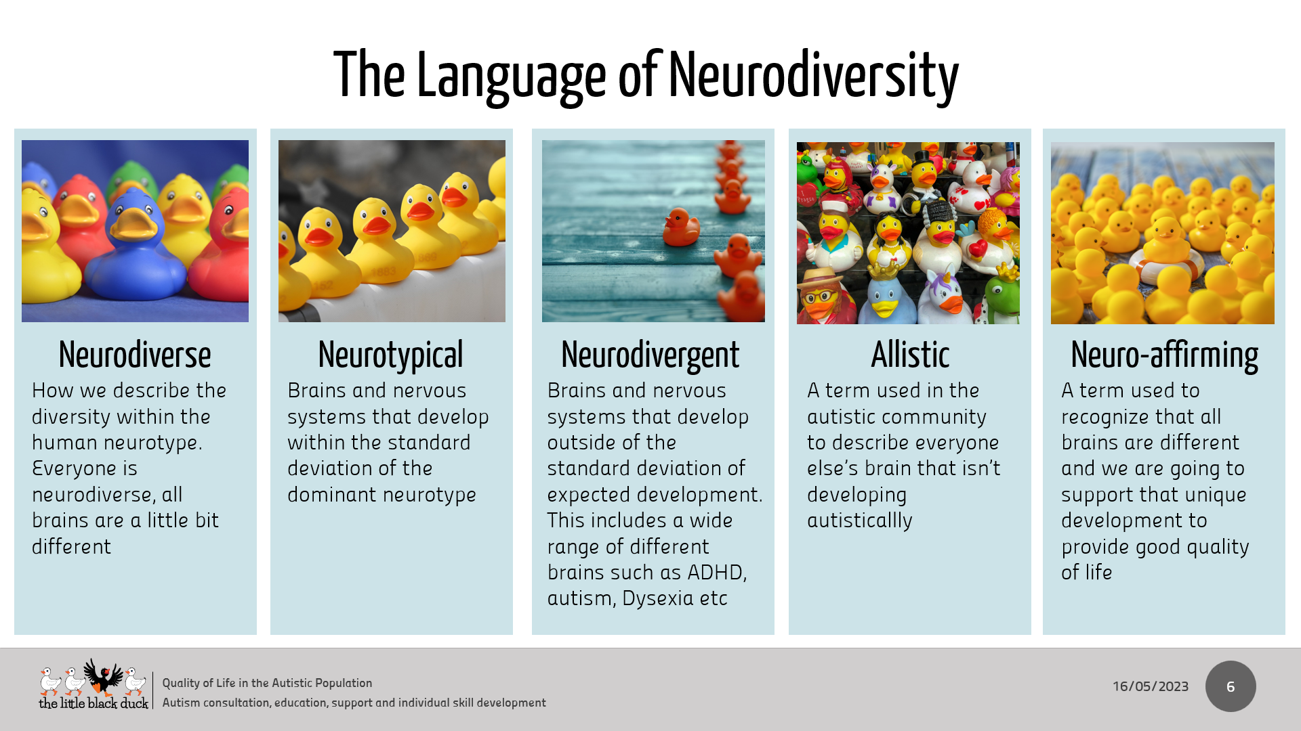
Notes:
MARK
As well, our language around Autism is also undergoing a rapid transformation.
Today we use –
We use the terms ‘autism’ or ‘autistic’
The terms; ‘On the spectrum’ and ‘ASD’ are potentially offensive.
Especially ASD because the ‘D’ in ASD stands for ‘Disorder’.
This it is not neuroaffirming language.
Today we use co-occurring - NEVER co-morbidity
We use, passion or special interest – NEVER obsession
I no longer use the word DIAGNOSIS.
The definition of diagnosis is the discovery of an illness, disease, or sickness.
Autism is none of these. Instead, I use the word – IDENTIFICATION
We no longer use the words, symptoms or impairments but talk about characteristics or experiences.
We acknowledge barriers and attempt to minimize, or remove them using specific supports, rather than applying high and low functioning labels.
In everything we do, we try to meet the double empathy problem.
I promise to unpack this for you because it is uplifting, connecting and empowering!
And we use words like “support,” “therapy,” “education,” and “strategies.” We avoid the words “treatments and fixes”

Slide 17

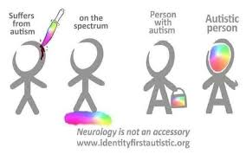
Notes:
MARK
We no longer use the phrase - “a person with Autism”.
It is not neuro-affirming because it frames Autism as baggage a person carries.
The truth is, their Autism is their neurotype.
It’s who they are.
It is how they see the world, process the world, and communicate with the world!
It is their identity.
A 15-year-old explained this to me.
She leapt up from her chair and grabbed her bag and walked around my room carrying it.
As she walked, her bag dangled about, and she said …
“Here’s a person with Autism. It looks like my Autism is separate from me.
It looks like I can pick it up or put it down whenever I want.
I can’t do that. My Autism is all of me, all the time.”
While identity first language is the neuro-affirming preference, I think it’s best to ask a person about the language they prefer.
We must respect individual choice.

Slide 18
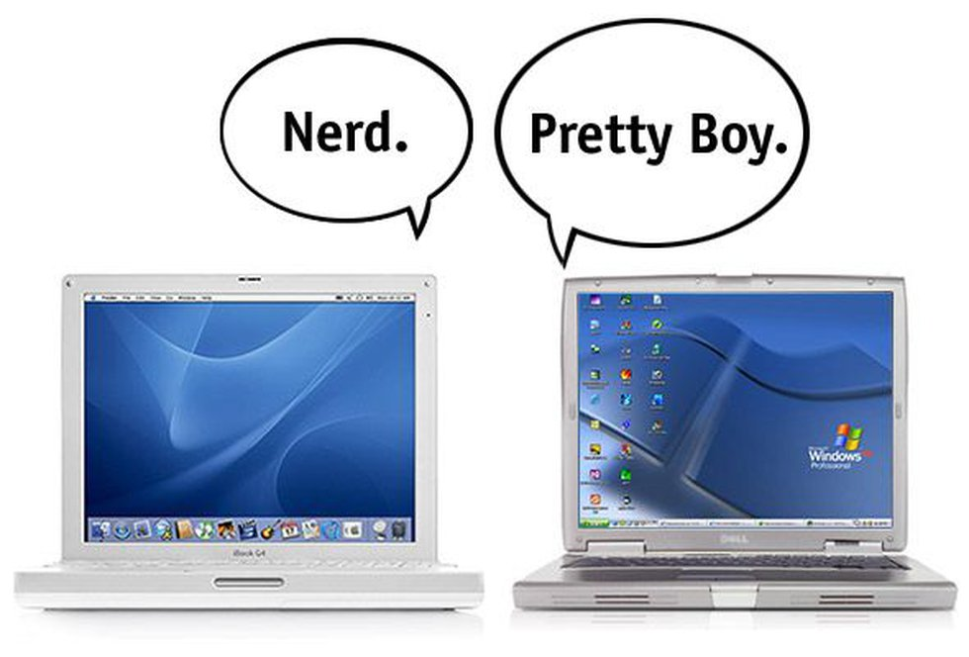
Notes:
MARK
So, parts of a neurodivergent brain look different because the brain is built and wired-up differently.
And because of this, a neurodivergent brain processes the world differently.
It will always do so, because its operating system is a beautiful variation of the human rhythm.
It’s like being a fabulous Mac living in a PC world.
There’s nothing wrong.
Just different; and this style brings strengths, and challenges too!

Slide 19

Notes:
But things are more complex than Mac and PC comparisons, if we are to be truly neuroaffirming.
It’s often said that we all sit on some kind of neurodiverse spectrum.
Probably.
Each of us is unique with combinations of abilities, needs, strengths, and challenges.
BUT … we are not all neurodivergent and/or disabled.
As well … being neurodivergent is not the same as being disabled or experiencing mental illness.
But disability and mental illness can be linked to neurodivergence.
It must be also understood, that for many, being neurodivergent and/or disabled becomes their core identity.
This is because everything within this person’s life is touched by it; their socialisation, cognition, communication and behaviour
It’s a consequence of their unique neurotype.
Today, this commands our deep respect.

Slide 20

Notes:
MARK
So, there are 2 FACTS to take away.
The FIRST is that our neurodivergent kids are not broken, not deficit, not disordered, and do not need to be fixed up.
They simply walk to the beat of another drum.

Slide 21

Notes:
MARK
The SECOND is they always will walk to the beat of THAT different drum.
They will grow up to be adults with Autism, or ADHD or whatever.
Please, let’s value neurodivergence so our kids can grow into it with pride.

Slide 22

Notes:
MARK
Every so often we’re asked to explain how 'What's the Buzz?' is neuroaffirming?"
It embraces that all human beings experience the social and emotional world differently.
All human beings have the right to express their feelings and actions in their unique and kind way.
This means we teach the ‘social and emotional code’, but equally coach that it’s perfect to show emotions, and empathy, and more, in ways that are authentic to oneself.

Slide 23

Notes:
MARK
We understand the notion of ‘masking’ where a person (especially an Autistic person) can be made to feel less, or vulnerable, and intimidated by not being true to themselves.
Our goal is to show there are 100’s of social and emotional issues that crop up in life, and there are 100’s of ways to work assertively, and kindly, with them, and sometimes solve them.
No one prescriptive way is ever right.

Slide 24

Notes:
MARK
The other focus has been to bring kids together, and hold a safe environment where they can joke, laugh, lean in together, while they learn.
And teaching ‘What’s the Buzz?’ has nothing to do with throwing a bunch of neurodivergents together and expecting them to come out as neurotypical.
The essence is getting young people to interact and gradually appreciate more and more about each other’s worlds.
As this happens, we discover authentic identity – the idea that not all brains travel the same developmental pathway, and this is something to be understood and supported. Even celebrated.

Slide 25

Notes:
MARK
Does this prompt any reactions or comments?
<<<<<<<<<<<<<<<<LISTEN TO COMMENTS >>>>>>>>>>>>
So, I have 2 points to make …
Firstly, we can’t change influences that are outside of our control.
But there are a bunch of things we can make a lot more of that are within our control.
This is a moment for us to take stock, to rethink our style, and make subtle changes.
Secondly, our kids have never needed us as much.
Most want to connect with us – even if at first, it’s somewhat on their terms.
I think there’s always room for growth within each of us– no matter how fabulous we are!
And we are fabulous!

Slide 26

‘What’s the Buzz?’ is an
- based program
‘What's the Buzz?’ clinical trials
In 2018 2,000 school students aged from 4 to 10 years of age, took part
For details - https://www.whatsthebuzz.net.au/main-menu/whats-the-buzz-clinical-trials
Notes:
NONI
'What's the Buzz?' is an evidenced-based program.
If you want, you can read all about the clinical trials on the ‘What’s the Buzz?’ website.
The results were outstanding.
The independent team of researchers found that the improvements measured in all categories were statistically significant.
Also, keep in mind that the sample of children who took part in the clinical trials was huge – 2,000 SA students participated.

Slide 27

What’s the Buzz? EARLY LEARNERS and PRIMARY lessons based on – “Introductions”
You might smile & say – “Nginti nankeri?” (Are you good?) You might answer – “Ngapi nankeri” (I’m good)
or “Ngapi nra:gi” (I am really good) or “Ngapi tau nra:gi” (I am not good)
Your ‘Back-to-back’ game is now our – “Yari Yari”
The kids walk around the room, when I call back-to-back (yari, yari), stand back-to-back
When I say Petji –Petji, stand face-to-face and take turns asking, “nginti nankeri?”
The other partner replies, “ngapi nragi” “Ngapi nankeri” or “ngapi tau nragi”.
Notes:
Noni
Recently, we were contacted by Lisa Bettcher, an Aboriginal Education Teacher, and her colleagues at Murray Bridge North School.
They have adapted the EARLY LEARNERS and PRIMARY programs to Ngarrindjer.
They now have their own cultural context to teach their Nunga students wellbeing and language.
Subsequently, an Aboriginal Education Lecturer at University of South Australia has offered to write an article to recognise what Murray Bridge North is doing with ‘What’s the Buzz?’ and Aboriginal language.

Slide 28
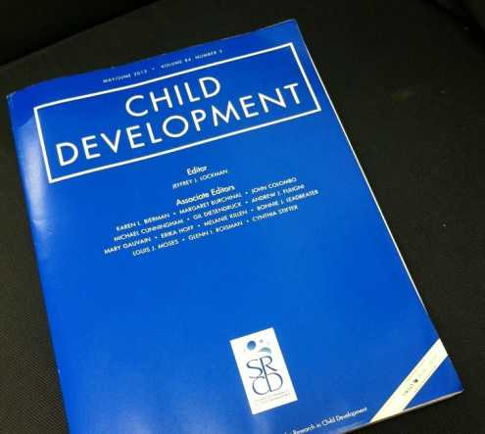

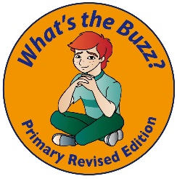


Got to be highly structured. Got to meet the ‘SAFE’ criteria
J. A. Durlak, et al. The Impact of Enhancing Students’ Social and Emotional Learning: A Meta-Analysis of School-Based Universal Interventions. Child Development. Volume 82, Issue 1, pages 405–432, January/February 2011
‘SAFE’ criteria enhances capacity for students to transfer skills
Sequenced - it follows a logical break down of skills
Active - it uses role-plays and rehearsal with feedback
Focused - it dedicates time to teach specific skills
Explicit - it teaches a specific skills each session
www.casel.org - The Collaborative for Academic, Social, and Emotional Learning (CASEL)
leads research and innovation in the area of social and emotional learning (SEL)
Notes:
NONI
‘What’s the Buzz?’ is built around the ‘SAFE’ criteria.
As you can see on screen this means it is a program that’s;
SEQUENCED– they follow a logical break down of skills
They’re ACTIVE - or kinesthetic. They’re all about the ‘doing’ using role-plays and rehearsal with feedback from peers
They’re FOCUSSED – in that time is dedicated to teach specific skills
And, finally, they’re EXPLICIT – by teaching the skills very specifically in each session
The ‘SAFE’ criteria enables a much better transference of skills from ‘the learning situation’ to the child’s ‘POINT OF PERFORMANCE’.

Slide 29

I received this feedback about ‘What’s the Buzz? and TEACHING VALUES of BEING HUMAN from a principal I admire.
She wrote, “Mark, we have some terribly vulnerable kids who don’t remember that they are loved. What you describe in your books is exactly what I have been on about this year… thank you, because these vulnerable kids are coming out of the woodwork at the moment (in line with the parent mental health issues too).
Thanks for writing educationally compassionate books that show the way with practical and humane techniques!”
“I admire a new vanguard of educators in schools who understand we must shift our thinking to ‘connection’ rather than relying the traditional and damaging forces of dominance, force and exclusion. Thank you for being with me today!”
Notes:
NONI
Finding one’s tribe - or knowing how to find it - is literally lifesaving.
And, the skills to do this begin early in young person’s life.
As mentioned, the WHO, sees the partnership of ‘loneliness, anxiety and depression’ to be a massive global health challenge.
Most vulnerable are children, teens and the elderly. But, none of us are immune.
What we are learning are that knowing how to create friendship and good community bonds are a vital protective factor against isolation and loneliness.
We see classrooms, and our BUZZ groups, as small communities that can be cleverly engineered so young people get to feel the joy of being with peers.
What a gift to give to the young people we work with!

Slide 30



The BIG 8 SEL capabilities;
teamwork
empathy
negotiation
leadership
coaching
learning
persuasive skills
emotional self-regulation
An informal approach
Guided interactions
A formal program
Use a specific program
Notes:
MARK
Here are the 2 roads that can be travelled when teaching SEL values.
What both approaches have in common is a focus on the big 8 SEL capabilities at the top left of screen.
The road to the right follows an informally generated approach.
The road to the left relies more on the delivery of purpose-built programs.

Slide 31
Bounce Back, www.bounceback.com.au/ Circle of Friends, www.kids-first.com.au/circle-of-friends/
Competent Kids, Caring Communities, www.ackerman.org ‘What’s the Buzz?’ www.whatsthebuzz.net.au
Cool Kids Program, www.mq.edu.au/about/campus-services-and-facilities/hospital-and-clinics/centre-for-emotional-health-clinic/programs-for-children-and-teenagers/
Fun FRIENDS Program, www.friendsresilience.org/fun-friends-ages-4-7/ GoZen, https://gozen.com/
I Can Problem Solve, www.researchpress.com/product/item/4628
iModelling, www.autismspeaks.org/autism-apps/imodeling%E2%84%A2-app
Lions Quest, https://www.lions-quest.org/ Tribes Learning Communities, www.tribes.com
Little Lunch, www.abc.net.au/tv/programs/little-lunch/ MindUP, www.thehawnfoundation.org/mindup
Movie Club: a social skills program, www.autismspectrum.org.au/content/movie-club-social-skills-
Open Circle, www.open-circle.org Optimistic Kids, www.optimistickids.com.au
PALS (Playing and Learning to Socialise), http://autismdecisionaid.com.au/pals-social-skills-program/
PEACEpack, https://news.flinders.edu.au/blog/2018/02/09/peace-pack-halves-bullying-adelaide-school/
Peaceworks: Peacemaking Skills for Little Kids, www.peaceeducation.org
Resourceful Adolescent Program, www.rap.qut.edu.au/ Sanford Harmony, www.sanfordharmony.org
Responsive Classroom, www.responsiveclassroom.org Secret Agent Society, www.sst-institute.net/
Rock and Water Program, www.rockandwaterprogram The Social Express, www.thesocialexpress.com/
Smiling Minds, https://www.smilingmind.com.au/ Seasons for Growth, http://seasonsforgrowth.co.uk/
Second Step, https://www.positivepieces.com.au/second-step
Social Decision Making/Problem Solving Program, www.ubhcisweb.org/sdm
The Incredible Years Series, www.incredibleyears.com
The Best of Friends, https://childpsychologist.com.au/service/workshops-info/the-best-of-friends/
Notes:
MARK
Here’s a glimpse of a few formally developed programs that I know a little about.
You’ll noticed ‘What’s the Buzz?’ with these!
These are planned and sequenced and programs you can buy off the shelf.
All the work has been done for you.
Some require training.
Most are ready to go!
There’s a lot to choose from!
When choosing a program;
choose one you are enthusiastic about
one that should meet the unique needs of those you’re working with
a program you can embed into your group, or into the community to strengthen the culture you want to build

Slide 32

The BIG 8 SEL capabilities;
teamwork
empathy
negotiation
leadership
coaching
learning
persuasive skills
emotional self-regulation
An informal approach
Guided interactions
Notes:
MARK
For now, I’m taking you down the road to the right.
A more informal approach to SEL.
These are often called, ‘Guided Social Interactions’.
They’re a captivating ways to engineer situations where individuals, often in small groups, need to listen, discuss, exchange opinions, negotiate and respond to different points of view.
What follows should provide you practical TAKE AWAY ideas!

Slide 33

Let’s ‘TEST’ your ‘social and emotional literacy skills!
An activity from Lesson 1 in ‘What’s the Buzz? for EARLY LEARNERS
One person begins by gently rolling the ball to someone.
As this person receives the ball they say, “Thanks, and tells ONE THING about themselves to the group.” It may be about a physical characteristic or idiosyncrasy, about an experience, something personal, something about identity, ethnicity, interests, loves, fears and goals.
Once done, they roll the ball to another.
The game continues and continues. Feel free to ask questions as you hear the most interesting things!
Notes:
MARK
Let’s grab a quick insight into the complexities of SEL skills by meeting one another!
This activity is straight from our EARLY LEARNER’S program.
One person begins by gently rolling the ball to someone.
As this person receives the ball they say, “Thanks, and tells ONE THING about themselves to the group.” It may be about a physical characteristic or idiosyncrasy, about an experience, something personal, something about identity, ethnicity, interests, loves, fears and goals.
Once done, they roll the ball to another. The game continues and continues. Feel free to ask questions as you hear the most interesting things!

Slide 34

Checklist:
Was your goal to win, or to have fun? What about your partners?
Did you listen to each other? Why? How did you do it?
Did you look at one another? Did this help?
How much eye contact did you use? Did you use any? Did they?
Did you follow your rules or their rules? How did you decide
Did both of you understand the rules?
Did you discuss whether you’d play competitively or casually?
Were you empathic towards one another? Why? How did you do this?
Did you keep to the rules even though you may have been losing? Did they?
Did you both ignore distractions and give your attention to each other?
Who went first? How did you decide that? Was that fair?
Were you confident about playing this activity?
Was your partner confident about playing this game? Did you notice?
Was the interaction even? Was there a leader and a learner?
What about misunderstandings? How did you handle them?
Notes:
MARK
This checklist provides a snapshot into the complexities required for successful interaction.
To have a successful interaction most of these questions must be answered in the affirmative.
And, suddenly, the depth of SEL skills unfold.

Slide 35
Checklist:
Did you take turns to talk and listen?
Did you look and sound interested?
Was everyone fair and cooperative? Were you?
Was your group great to be with? Were you?
Were they helpful? Were you?
Were you all sensitive to each other’s needs?
Did you match one another’s energy levels, so the interaction felt even?
Did you ‘go with the flow’ or was someone rigid or overbearing?
What does ‘going with the flow’ mean and why is it an important skill?
Did you need to be assertive because things didn’t go right?
Were you socially responsible? Were your partners?
Did you act emotionally predictably? Did the others?
Did you all show kindness, playfulness and friendship?
Did you try to give your group a good time?
What was most important? Getting your story across, or building relationship?
Did you synchronize your goals? Did both achieve them?
Notes:
MARK
Guided Social Interactions allows confidence and skills to grow.
They can awaken a desire to be with others and value them.
Simple activities provide an engaging structure to continuously coach your group!

Slide 36
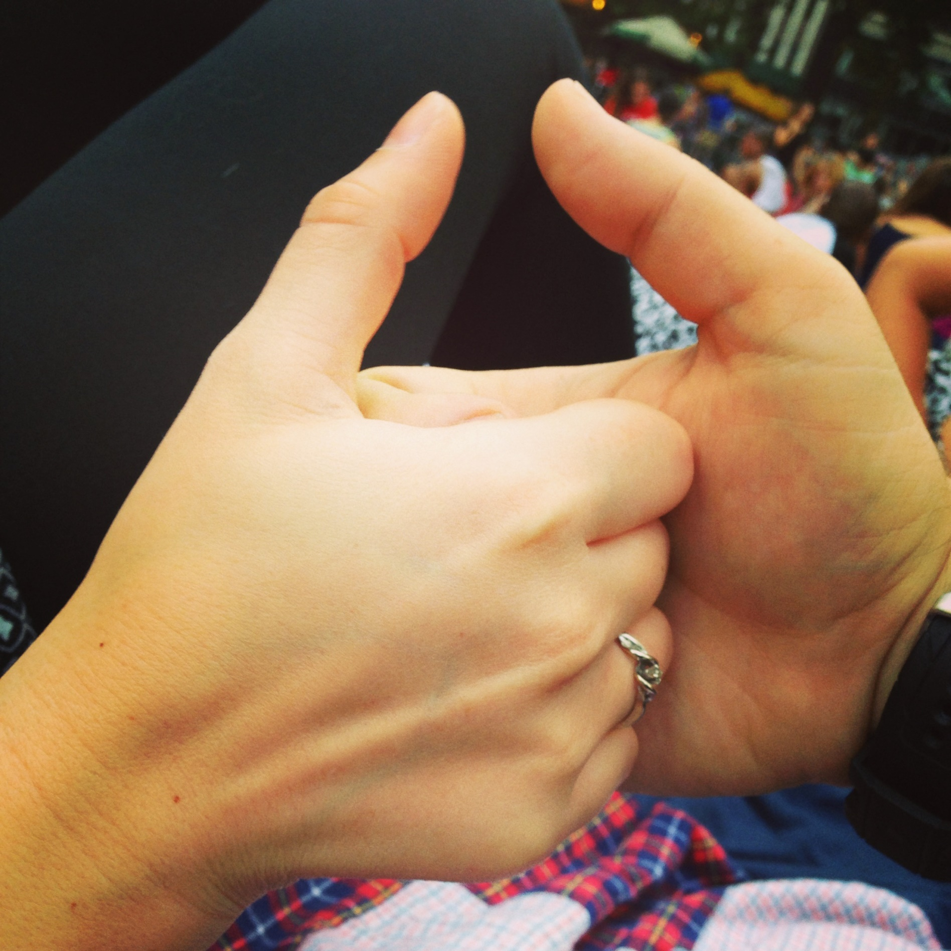
Guided interactions; Thumb Wars
TARGET SKILLS -
teamwork, negotiation,
empathy, learning,
coaching and
self-regulation
"One, two, three, four, I declare a thumb war," while
passing thumbs over each other in time with this rhyme.
The rhyme is sometimes extended to "Five, six, seven,
eight, try to keep your thumb straight."
Notes:
NONI
What about if we play ‘Thumb Wars’?
Do you know how to play it!
But, does your partner know?
Do you both use the same rules?
How will you establish a starting point?
Will you begin with a little ‘slow motion’ practice before you go competitive?
Then what?
Will you challenge each other – start slow – help each other?
Or, will you be competitive and go for it?
What cues will you use to see if you have a competitive or cautious partner
JUST TRY TO REMEMBER THOSE SKILLS WE HAD IN THE SCREEN EARLIER!

Slide 37
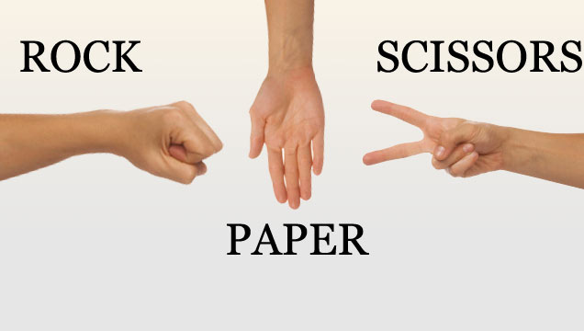
Guided interactions; Rock, paper, scissors
TARGET SKILLS -
empathy, negotiation, coaching and learning as well as self-regulation
Notes:
NONI
Let’s move to ‘Rock, paper, scissors’.
Yes, we want it to be fun, but it’s not frivolous!
When working with a group, you might turn their attention to the TARGET SKILLS on screen.
You might task someone to step up and take on the role of COACH, to lead, yet be sensitive to the learner’s or group’s needs.
You might ask another to be the LEARNER and use LEARNER’s skills - to actively listen, watch, participate and seek clarification.
You may even ask someone to be an OBSERVER and REPORT BACK the skills they witnessed between group.
Encourage them to explain why some interactions worked well and how they might have improved.
Oh? If you’re thinking this is all about teaching littlies, well, you couldn’t be more wrong.
This is about teaching people of all ages, with and without, beautifully diverse abilities.
This is about building and maintaining a social and emotional ‘sweet spot’ so these understandings and skills become culturized.

Slide 38
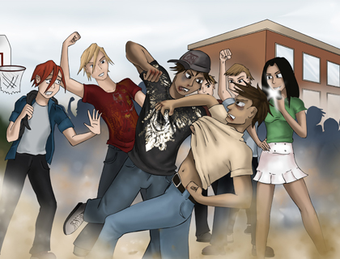
Why teach SEL skills to teens? Especially boys? Aren’t they past this?
They are dependent on environments and connections that deliberately engage them in this ‘empathic sweet spot’.
Notes:
MARK
On this … the research indicates a measurable decline in ‘emotional empathy’ in males between the ages of about 13 and 16.
This decline relates to a sharp 14-fold increase in testosterone levels at this time.
As you know testosterone rouses dominant and aggressive behaviours in young males which oppose compassion, tolerance and understanding.
So, during this time it is harder for teen boys to put themselves ‘into the shoes’ of another and respond compassionately.
As well, adolescent males around this time are often strongly influenced by social pressures telling them to ‘act like a man,’ ‘be tough’, 'hit before you get hit,' ‘suck it up’ and never show weakness by displaying emotions.
They are hugely dependent on environments and connections that deliberately engage them in this ‘empathic sweet spot’.
And, with the tragic shadow of ‘Domestic Violence’ constantly looming over us, this is a reminder that boys don’t emerge from the womb knowing how to treat women.
It takes years of thoughtful modelling from ALL OF US for them to absorb how it’s truly done and WHY.

Slide 39
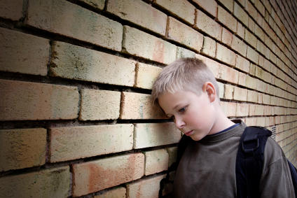
What is ‘social and emotional literacy’? Why teach it?
Social and emotional literacy includes nonverbal and verbal interactions. It starts as soon as children begin to communicate.
It includes the ability to understand your emotions, the ability to listen to others and empathise with their emotions, and the capacity to express emotions productively.”
First definition by Claude Steiner 1997
Social and emotional literacy (SEL)
Notes:
MARK
What is it to be ‘socially and emotionally literate’?
It is to be ‘in-tune’ with what’s happening around you, and to be able to handle your emotions in a way that improves the quality of your life AND those with you.
So, this means we talk openly to young people about their emotions, and the feelings of others.
We teach kids about the strong link between emotion and behaviour.
And, how to see it in themselves and in others
We share that some find it easier to self-regulate in the trickier moments, but there are loads of ideas and methods to manage everything we experience a whole lot better.
Oh? Just look at the date.
Historically, it is not that long ago.
But progress is being made and it’s evidenced in the fact that we’re all here together enthusiastic to know more about it.

Slide 40

Why teach SEL?
And, can anyone teach it?
4 FACTS
SEL abilities are teachable
All human beings benefit from being taught these skills
Mental health is enriched when individuals ‘live’ within a visible SEL
framework because feeling valued and belonging to peers is momentous
A SEL framework in classrooms brings at least a 10% gain in academic achievement
Notes:
MARK
The research tells us 4 FACTS about teaching. They are on screen.
And, to the second question; can anyone teach it?
The shift in emphasis to support young people find a ‘broader definition of success’ is not an ‘easy fit’ for some educators; teachers and parents.
While it can be easily integrated into a family, class or a group’s culture, it will feel foreign to those who’ve not experienced it in their formative years or work in a space where it’s been absent.

Slide 41
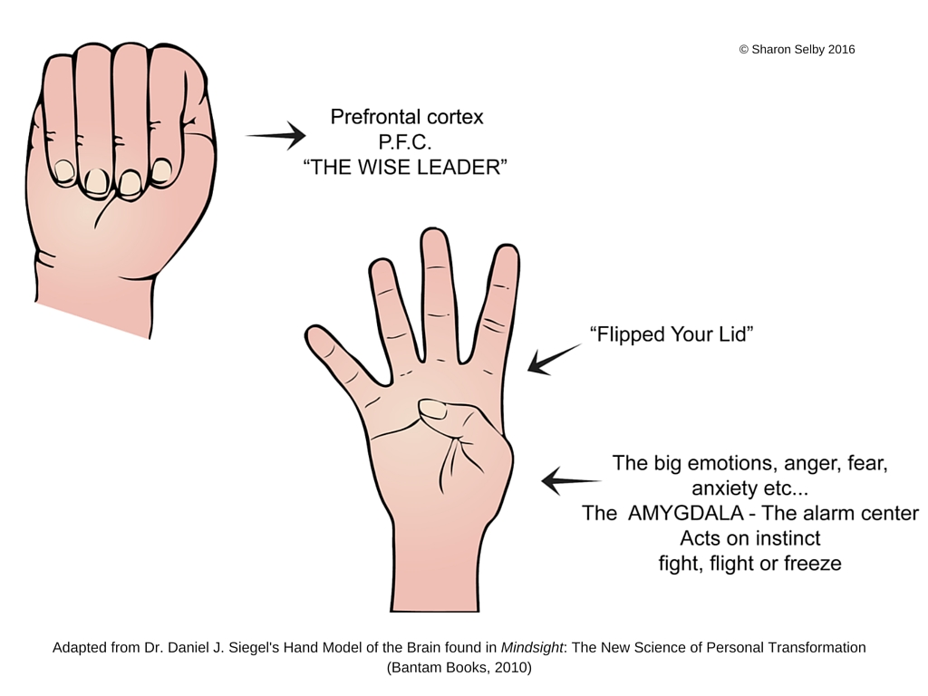
Dan Siegel’s ‘Brain-hand model’
Notes:
MARK
A ‘Socially and emotionally literate’ environment’ offers the opportunity to introduce Dan Siegel’s hand model of the brain to give them something physical to base their thinking on!
To do this, hold up your fist with your thumb tucked into the centre of it.
Turn your fist to the side so students are looking at a profile of the brain. Get them to do the same.
The fingers wrapped around your thumb represent the brain’s frontal cortex, and the thumb is the limbic area.
In the limbic area has connections upwards to the frontal cortex, and downwards to brainstem.
The brainstem is connected to the body through a number of regions including the spinal cord which is represented by your wrist.
The brainstem takes in information from the body and helps to regulate breathing, digestion and heart function. It also has the amygdala, which creates the fight, flight, freeze and faint response that happen when we feel threatened.
When brain systems are not integrated the brain becomes unbalanced, chaotic, wild and rigid.
Now, flip your fingers and thumb right out and explain to students this is when we’ flip our lids’ or ‘lose it’.
Look at the fingers; the prefrontal cortex is no longer connected and working.
And look at your thumb (our feelings). All our sensitive feelings are no longer being kept safe by our prefrontal cortex, but are hanging out, unprotected and hurting by an compromised limbic system.
What we’ve just done is powerful.
We know from brain imaging studies that this knowledge helps direct our attention to areas that help activate the regions capable of supporting us.
And, with practice, every child (even us) can improve the function of our brain.
We know that for a fact.

Slide 42
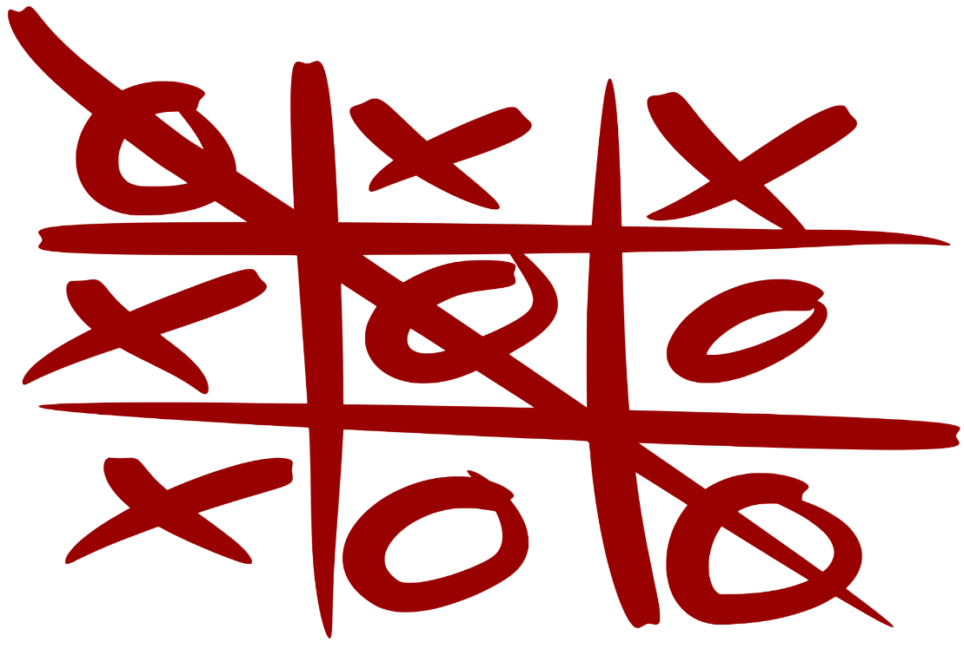
Guided interactions; Noughts and crosses/ Tic Tac Toe
TARGET SKILLS -
empathy, negotiation, coaching and learning as well as self-regulation
Notes:
NONI
Another way to set young people of all ages up is to play ‘Noughts and Crosses’ for a few minutes.
Again, this isn’t as easy as it first appears.
Often, one player can dominate over another, and a bad feelings can quickly emerge for the losing player.
Draw their attention to the TARGET SKILLS
Why not give each of the players a role so the focus skills are at the fore.

Slide 43
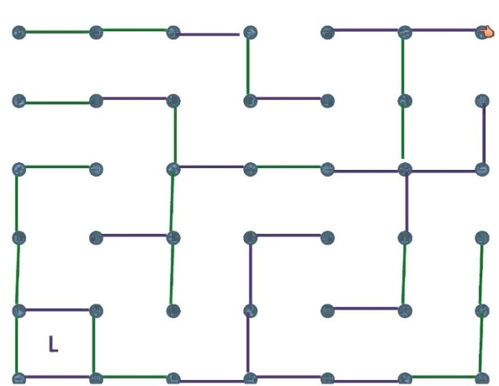
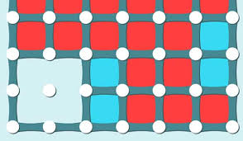
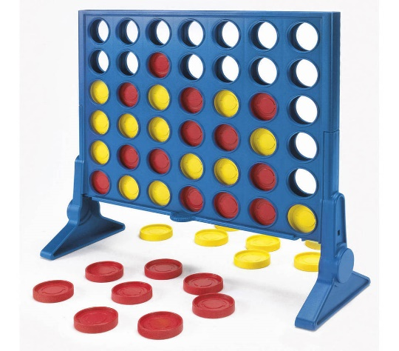
Guided interactions; Boxes and Connect 4
TARGET SKILLS -
empathy, negotiation, coaching and learning and self-regulation
Old school – play on paper
Electronic versions are available
Notes:
NONI
There’s ‘Dots and boxes’ and ‘Connect four’
Old school and online versions!

Slide 44

Guided interactions; Pictionary
TARGET SKILLS -
empathy, negotiation, persuasive skills, teamwork and self-regulation
Notes:
NONI
What about, Pictionary?
It’s the classic charades word-guessing game.
And, it’s great for small groups who are getting to know each other
This game is a lot of fun for ages 10 years and older.

Slide 45

Guided interactions; Monopoly Deal
TARGET SKILLS -
empathy, negotiation, persuasive skills, teamwork and self-regulation
Notes:
NONI
And, Monopoly Deal, but be warned – it is delightfully provocative.
The aim is to collect properties and steal from your opponents. And, other players will steal from you too!
It plays between up to five players, takes about twenty minutes to play and has a free Shuffle app.

Slide 46
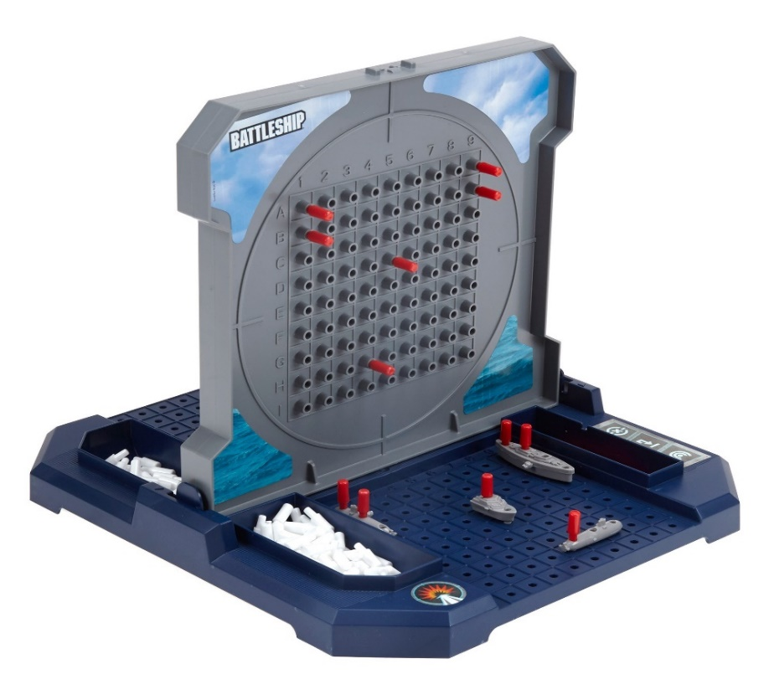
Guided interactions; Monopoly Deal
TARGET SKILLS -
empathy, negotiation, persuasive skills, teamwork and self-regulation
Notes:
NONI
Battleship is a game for two players, or two teams of 2 players can battle.
There’s the standard game onscreen and also an online version.
The game involves listening, remembering, organising, critical thinking and pure luck!

Slide 47
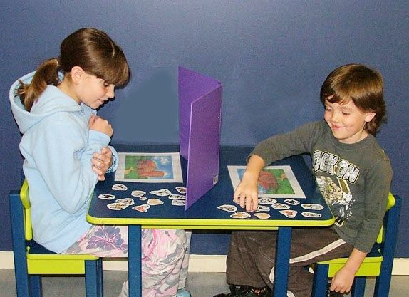
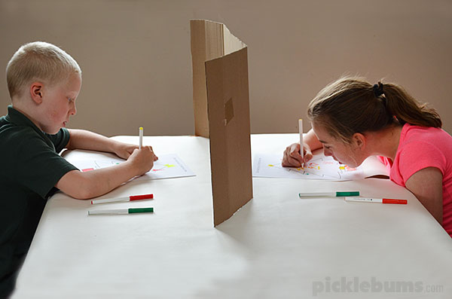
Guided interactions; Barrier games
TARGET SKILLS -
empathy, coaching, leading, listening and self-regulation
Notes:
NONI
Barrier games are an engaging way to develop a young person’s listening, language, attention and social skills.
Plus, they also assist with understanding of concepts around time, space and directions.
On screen, these kids are playing in pairs, but you can set kids up in groups of 3 or 4 with one being the speaker, and the others the listeners.
Every player will need the same set of materials and a barrier.
The aim is for the speaker to gradually arrange their materials behind their barrier while telling the listener or listeners how to position their materials in the same way.
When completed, the barrier is removed and both the speaker and the listener should have their materials positioned the same.
You can use include;
miniature objects
small toy animals or figures
sticker sets
picture cards from games
coloured pencils and paper
real objects
maths materials
Lego
draw pictures together
Just google barrier games, or look on Pinterest. There are zillions of ideas for ALL ages, yes, even for teens and adults!

Slide 48
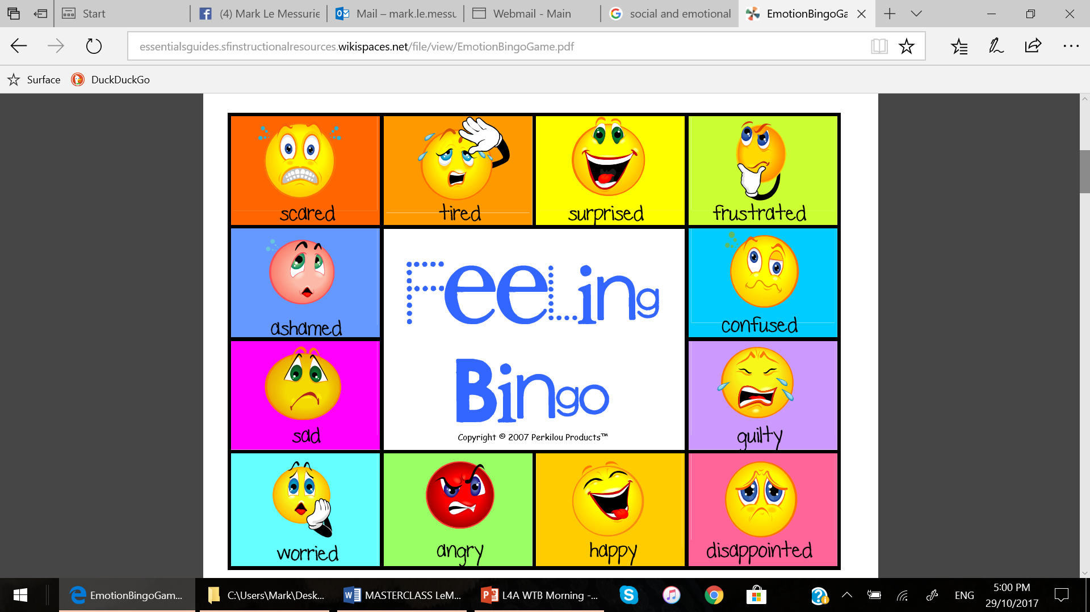
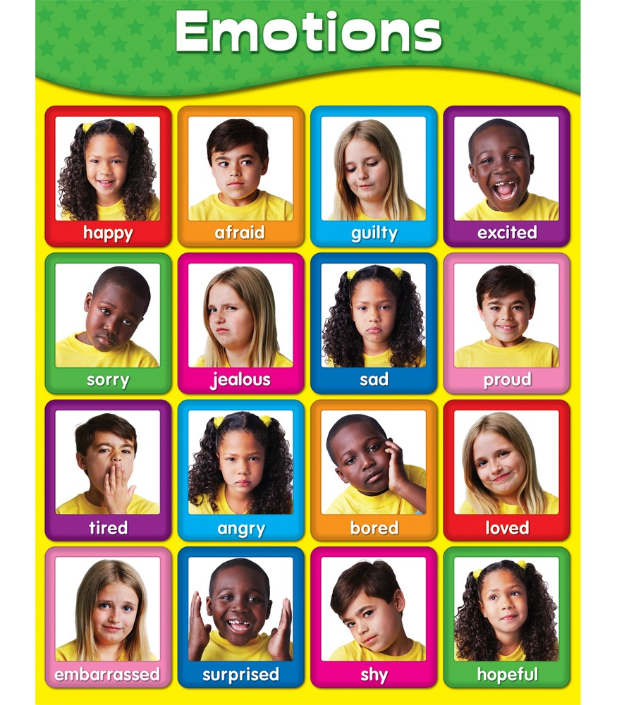
https://www.teacherspayteachers.com/Browse/Search:emotions%20bingo
https://safe4kids.com.au/product/feelings-bingo/
http://www.momentsaday.com/empathy-game/
http://essentialsguides.sfinstructionalresources.wikispaces.net/file/view/EmotionBingoGame.pdf
Notes:
NONI
Don’t be fooled, ‘Feeling Bingo’, isn’t just for littlies.
It’s for every age group.
It can start as simply as you holding an emoji, calling it’s feeling and asking your group to cover that emoji on their card.
First with 4 wins!
Or, for older students, you can increase the difficulty by reading a situation that strongly features a particular emotion.
Their job is to cover the emoji on their card that matches this emotional circumstance.
And why might we play BINGO at any age?
Because the research tells us the more we engage young people in talking about emotions and naming them, the more we strengthen their emotional competence.
Be sure to pop the website, ‘Teachers pay teachers’ on to your favourites as this site offers lots of empathy styled games and resources for the cash strapped!

Slide 49
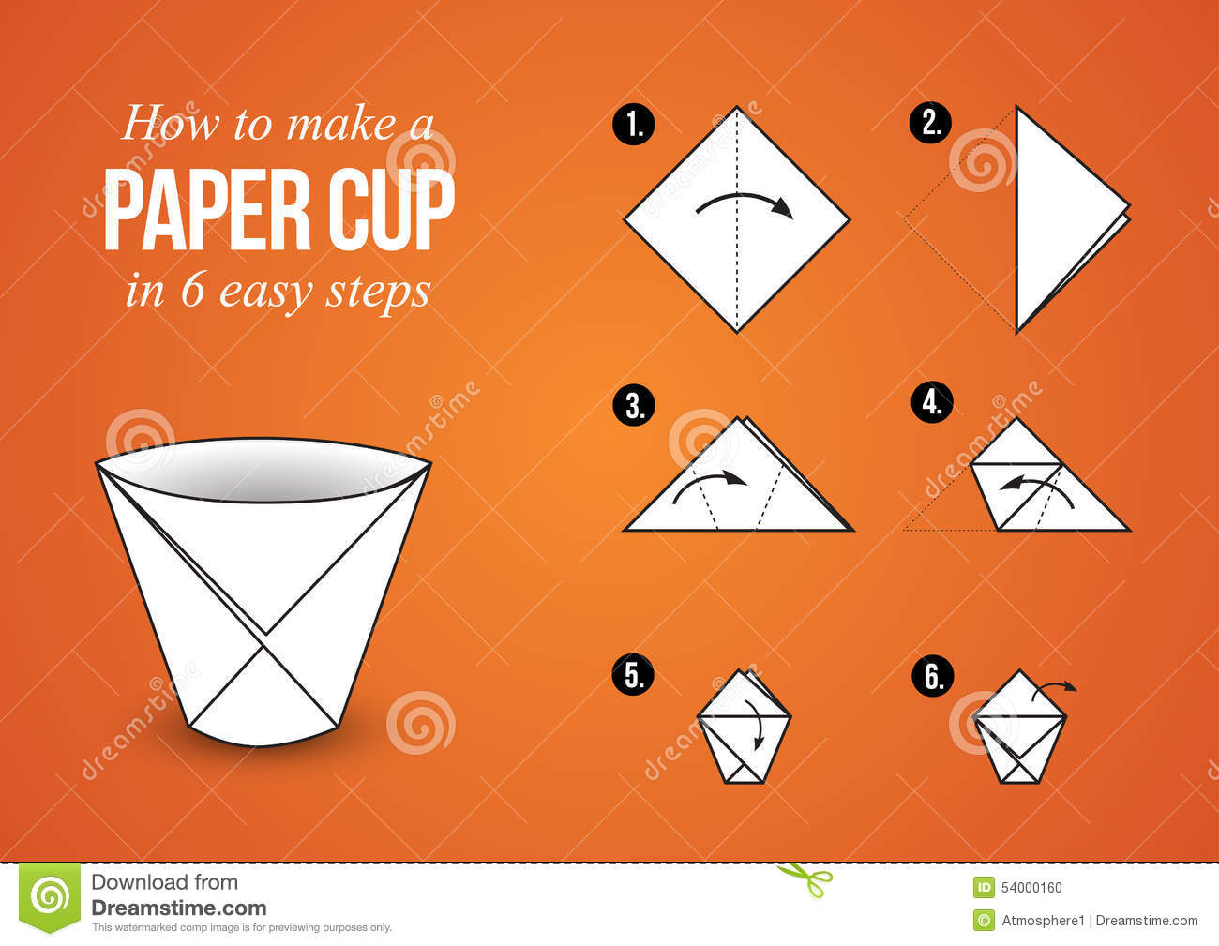
Guided interactions; origami paper cup challenge
TARGET SKILLS - teamwork, empathy, listening and learning
Notes:
NONI
Try this, ‘origami paper cup’ challenge with a group.
Let’s do this ourselves!
Each of you have an origami sheet, or similar.
Our challenge is to use our EMPATHIC qualities, work together AND help each other build a paper cup that can hold water long enough to drink from it.
The FOCUS isn’t to WIN!
It’s for each person to support others, so everyone successfully builds the paper cup.
Have a water bottle at the ready so everyone can drink from their cup to celebrate!

Slide 50
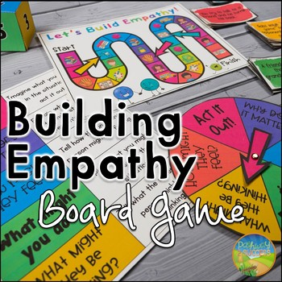
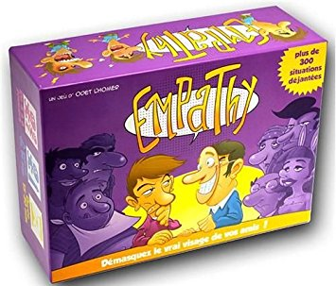
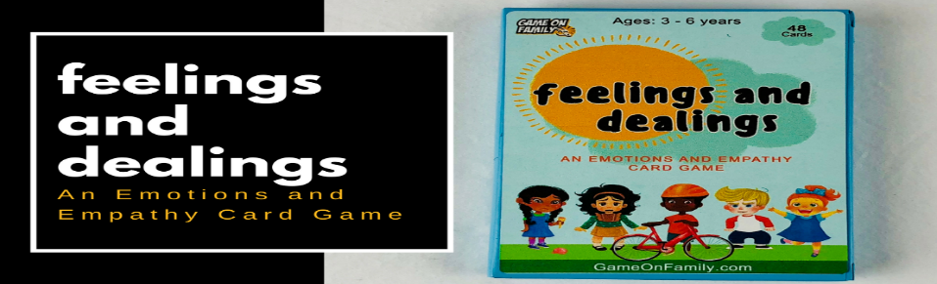

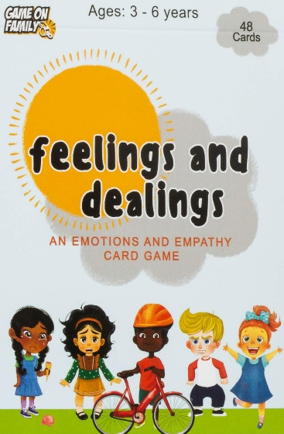
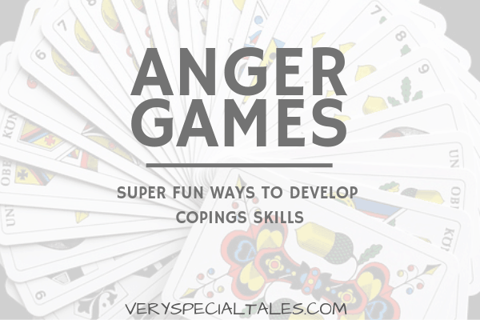
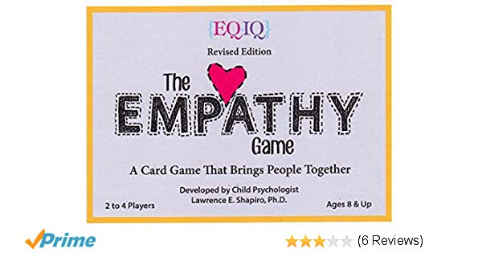
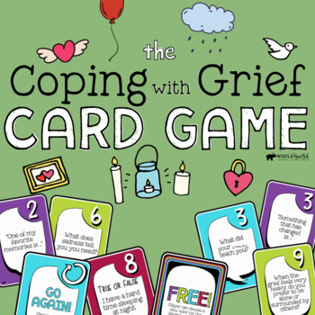
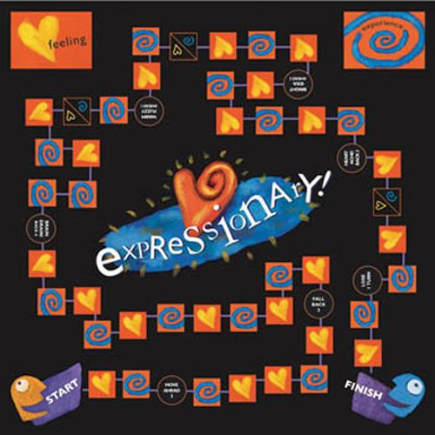
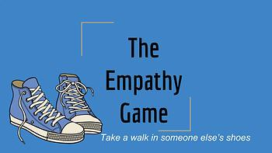
Notes:
MARK
Keep in mind that there are a host of ‘board games’ and ‘card games’ commercially available that teach empathy through to better coping skills.

Slide 51
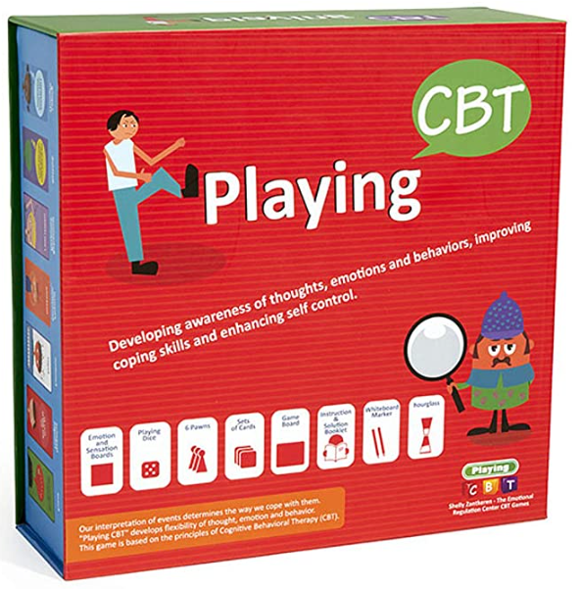
“As a principal of middle school, I highly recommend this. There are many cards and plentiful options.
I use the game for kids as well as for teachers. It is suitable for teachers as a tool to gain a better understanding of the emotional experiences of the kids.
We use it as a platform in group work to enable children to express their feelings and share their experiences.”
Notes:
MARK
This is a new game developed by a friend’s, friend.
It was released world-wide just this year and is designed for therapists, counselors, educators to use with children and adolescents.
It’s fun and provides a way for improving social skills, emotional regulation, emotional awareness and flexibility.
I love it!

Slide 52
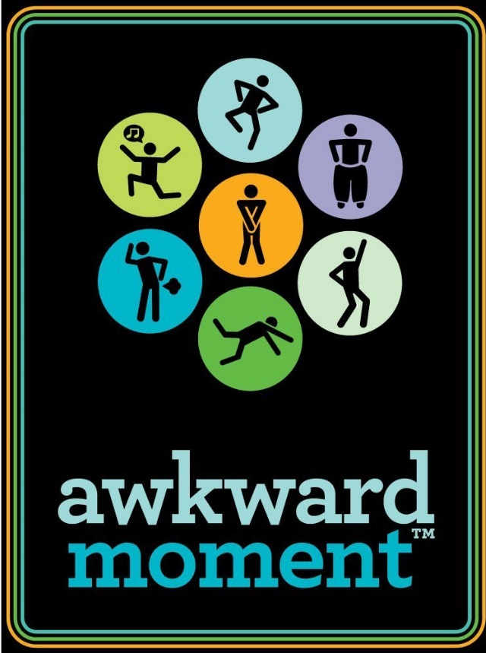
Guided interactions; awkward moment
TARGET SKILLS -
teamwork and empathy, as well as persuasive skills!
https://www.youtube.com/watch?v=15UnBq0QKjo
Kaufman G and Flanagan M. 2015.
A psychologically “embedded" approach to designing games for prosocial causes.
Cyberpsychology: Journal of Psychosocial Research on Cyberspace, 9(3), article 1.
Notes:
MARK
This is a favourite of mine I use with teens.
‘Awkward Moment’, provides opportunities for social and emotional growth.
Players try to impress the Decider by offering their best empathic response from their hand of cards!
The research tells us that compared to students in a control group, kids assigned to play this game showed improvements in their ‘ability to imagine another person's perspective’.
They also showed greater social and emotional flexibility.

Slide 53


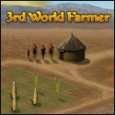

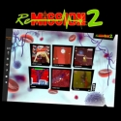

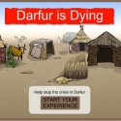
Middle School Confidential 1: Be Confident in Who You Are
(upper primary school age)
Who Am I? Race Awareness Game (upper primary school age)
3rd World Farmer (middle school age)
Journey (middle school age)
Re-Mission 2 (middle school age)
Spent (middle school age)
Guided interactions; empathy games/adolescents
TARGET SKILLS - empathy, negotiation, leadership and learning
Darfur Is Dying (year 9, upwards)
Notes:
MARK
There’s a new genre of video games that focus on empathy, social awareness, social justice, relationship building, our connection to the planet’s ecosystems and pro-social behaviours.
Do they work? Do they teach skills? Do they convince young people to become more empathic?
At this point the research is encouraging, but far from conclusive.

Slide 54


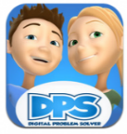




Avokiddo Emotions (Kindy to year 1)
Cool School: Where Peace Rules (early school age to year 2)
My DPS (early primary school)
World Rescue (middle primary school years)
Zoo U (middle primary school years)
Doki-Doki Universe (middle primary and upwards)
Quandary (upper primary)
Guided interactions; empathy games/children
TARGET SKILLS - empathy, negotiation, leadership and learning
Notes:
MARK
What matters most, is that this medium is now being developed to teach sharing and perspective taking, compassion, tolerance, forgiveness and a host of pro-social values.
What’s more, is that this platform has the potential to reach millions of people of all ages.
While a video game won’t make us a better person, they are a worthy addition to a combination of approaches nested in a broader framework.

Slide 55
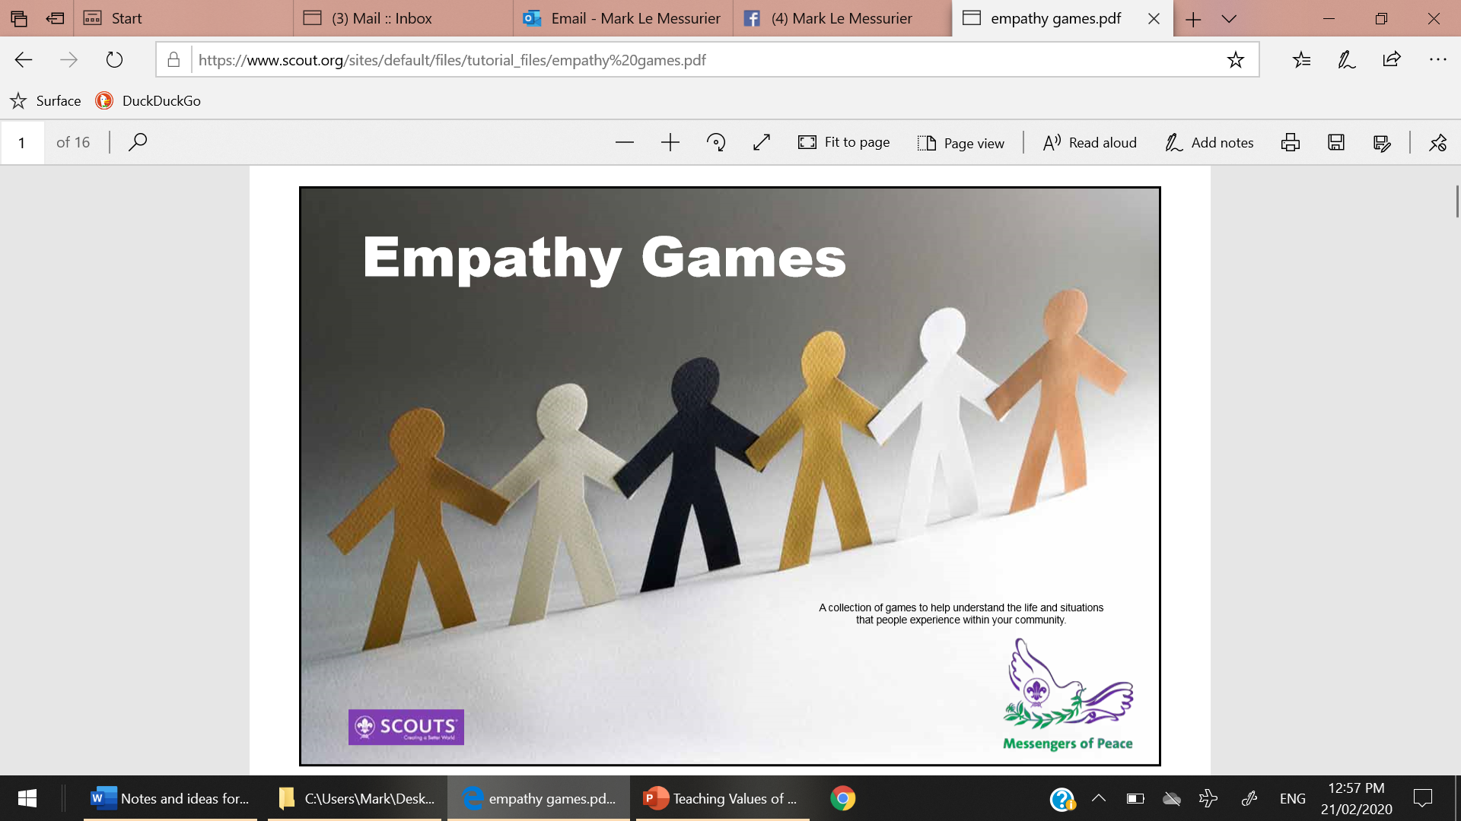
50 ‘ACTIVE’ EMPATHY GAMES
https://issuu.com/scoutlearningplace/docs/empathy_games?epik=dj0yJnU9TFBqeGpENDhoVUZocEJKUWl2U0drZG9iN2Zqa190ZzUmcD0wJm49QVpWRHlMUmhDb1lDa2dhV2t4Ny1zZyZ0PUFBQUFBR1AxYXZz
Notes:
MARK
I love this PDF.
It’s big, so keep it on your desktop. But, if you must print it, print it at work with work’s ink!
It’s filled with so many quality activities to help embed SEL skills.

Slide 56
Guided interactions; using games to promote SEL
Red Rover
Musical Chairs
Charades
Farmer in the Dell
Scavenger Hunt
Bowling
Arm wrestling
Thumb wrestling
Spelling bee
Potato sack races
Hangman
Tic-tac-toe
Obstacle course
Human knot
London Bridges
Frog races
Water balloon fight
Silly relay races
Guessing games
Red Light/Green Light
Mother May I?
Kick the Can
2 Truths and 1 Lie
Memory Games
Bingo
Staring Contest
Not-Laughing Contest
Piggy Back Rides
Jump rope contest
Wheel-barrel races
Hokey Pokey
Two-Square
Over and Under
Shadow Tag
Tug-of-War
I Spy
Miss Mary Mack
Cats in the Cradle
Leap Frog
Rock/Scissor/Paper
Flash Card Challenge
Guess name pinned on your back
Flashlight Tag
Freeze Tag
Statues
Little Sally Saucer
Marco Polo (swimming)
Who Stole the Cookie from the Cookie Jar?
Parachute
Hot/Cold (find hidden items)
Hide and Seek
Monkey in the Middle
Simon Says
Concentration
Chinese jump rope
Four Square
Beachball volleyball
Ali Baba & the 40 Thieves
Buzz (7’s)
Capture the Flag
Easter egg hunt
Lip sync
Pickle
Limbo
Crab walk soccer
Wacky Walks
Heads Up 7-Up
Crack the Whip
Steal the Bacon
Button, Button, Who Has the Button?
Telephone- Tongue Twisters
Pin the Tail on the Donkey
Follow the Leader
Penny pitching
Duck Duck Goose
Drop the Handkerchief
Hot Potato
Doggie, Doggie Where’s Your Bone?
Beanbag toss
Fruit Basket Upset
Guess Who
Name That Tune
Keep the Ball up
Shoe Scramble
Treasure Hunt
Pop Goes the Weasel
Hopscotch
Port and Starboard
Sardines
Spud
In & Out the Windows
Tag
Grandma is Crazy
Trust fall
Frisbee Tag
Wink murder
Notes:
MARK
To round up, as you look at this screen you could be forgiven for just seeing a bunch of games.
I see much more.
I see opportunities to connect, to build community skills, Emotional Intelligence and critical thinking skills.

Slide 57
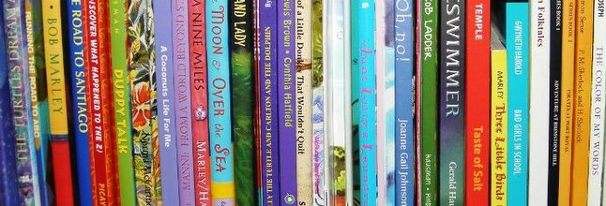
Guided interactions; Stories and discussion to boost EQ
Dewar, G. (2015) Evidence-based ideas to help kids communicate, connect, empathize, and read minds
http://www.parentingscience.com/social-skills-activities.html
Notes:
NONI
Children’s literature has long been a source to teach all sorts of concepts.
So it’s no surprise that the research has now proven the value of using children’s literature to build emotional awareness and resilience.
Stories assist us to showcase the challenges that people face while presenting ways to cope, or even overcome them.
The conclusion is that when kids participate in well-constructed conversations that analyse the behaviour and emotions of characters in stories, they develop their ‘empathy’ and ‘social and emotional mind-reading’ abilities.

Slide 58

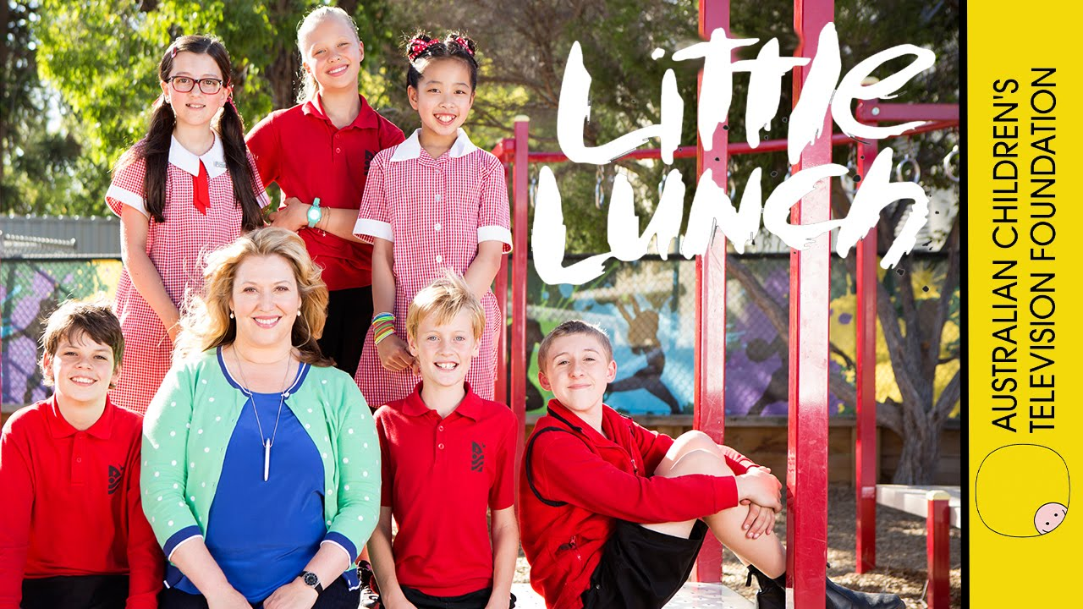
Guided interactions; video and discussion to boost EQ
ABC iView
Little Lunch is also a collection of books by Danny Katz and illustrated by Mitch Vane
.
Notes:
NONI
Never forget the value of video too.
LITTLE LUNCH, is ideal for groups aged 8 years and upwards!
Little Lunch is an Australian mockumentary.
Each episode runs for about 20 minutes capturing a ‘social and emotional issue’ at ‘Little Lunch’ time.
It’s a candid look at primary-school life, and the stuff that really happens out there!
They are a great catalyst for conversations that analyse the behaviour and emotions of others.
Plus, there’s an educator’s guide and app to download so young people can create their own stories with the same feel.

Slide 59


Milly, Molly - https://www.youtube. Season 1 and 2 - com/channel/UCgy56xh2RsxIspWwIVcGagQ
Guided interactions; video and discussion to boost EQ
Ideal for children, 4 to 7 years
Notes:
NONI
Then, there’s Milly, Molly. It’s UK based.
There are 30 episodes. Each runs for about 10 minutes.
They are the best of friends but have very different backgrounds and interests.
In each episode the girls, and their friends, experience new adventures and the classic ‘social and emotional’ challenges that teach valuable life-lessons.
Kids adore them.

Slide 60

Guided interactions; video and discussion to boost EQ
Daniel Tiger's Neighbourhood (preschool and early school-aged children)
4 year old Daniel Tiger and his friends learn the range of social and emotional skills needed for growing and getting along
4 Seasons on Netflix Many free on YouTube 20 to 40 episodes in each season 25 mins per episode
Notes:
NONI
Daniel Tiger's Neighbourhood is a beautiful American-Canadian animated children's television series.
Daniel Tiger, Mom Tiger, Dad Tiger and his friends are beautifully rich characters.
A social-emotional theme, such as disappointment and sadness or anger, or being thankful or appreciative is the basis for each episode.
The theme also uses a musical "strategy songs", to reinforce the life lesson.
Many of the "strategy songs" are available in albums or as singles.

Slide 61

Guided interactions; video and discussion to boost EQ
ClickView and iView
Best for children under 7 although adults adore Bluey
Notes:
NONI
Bluey is an ABC KIDS production available on iView.
She is a 6 year-old Blue Heeler dog.
Her popularity has exploded into winning a Logie and winning a second season of production.
Currently, there are 52 short episodes available.
Situations like going to the supermarket, playing with friends, sharing, waiting, finding the right friends, being cooperative and visiting the doctor become life lessons in navigating life.

Slide 62

Guided interactions; video and discussion to boost EQ
- https://www.youtube.com/channel/UCyG6ZCj6weaA2_JvnUWWlVA
Bing
Bing is best for children aged 4 to 7 years
Notes:
NONI
Finally, don’t forget, ‘Bing’.
Bing celebrates the realities of life, and getting along with others.
Each episode offers a mini-drama that explores what the ‘social and emotional complexities’ of pre-schoolers, and the grown-ups in their lives.

Slide 63

Little J and Big Cuz is best for children aged 5 to 8 years
Notes:
NONI
Also, there’s - Little J and Big Cuz.
’Little J, is 5 and Big Cuz - she’s nine.
They’re a couple of Indigenous Australian kids living with their Nanna and Old Dog.
Little J and Big Cuz is filled with the ups and downs of life - in playground, in the classroom, in the backyard, in the family and with friends.
It is beautiful – you and your kids will find plenty to discuss.
With the help of Nanna and their very special teacher, Ms Chen, Little J and Big Cuz discover the complexities of culture, community, and country.

Slide 64


Guided interactions;
what does community look like?
Notes:
MARK
To start to wrap up I want to return to the notion of community.
As human beings we are wired to belong. And from an evolutionary perspective if you didn’t belong to community you did not survive.
Today it’s different.
Today, if you don’t belong to community – family, extended family, classroom, school, clubs, associations or special interest groups the risk of mental health challenges are high.
But, building community starts with us.
It starts with our effort to build the skills and confidence in your young.
We need to culturize our homes, classrooms and schools so community has a reverence.
The benefit of a connected community goes like this.
A teacher brought enough balloons to school for every child in her class.
Then she asked the children to blow them up and write their name on their balloon. They threw all the balloons into the gym and the teacher thoroughly mixed them up.
Next, the teacher gave them 5 minutes to find the balloon with their name on it. It was chaos. The children ran around, looking frantically and time ran out.
Only a few had found their own balloon. ⠀ Then, the teacher explained what community means.
It means we work together supporting helping and looking out for each other.
She suggested that this time, when they start again, that each student picks up the balloon closest to them and walks it it to the person who’s name is on it.
In less than 2 minutes everyone was standing still and holding their own balloon. ⠀ The teacher smiled and said, “You just did community. Happiness, friendship,even the goals and promises we set our self, is always improved by working together.” ⠀

Slide 65

Let’s review
Notes:
MARK
Let’s review our learning before heading off to lunch.
To do this we’ll play ‘BACK to BACK’ and we’ll adapt it to meet our SPECIAL needs!
When I say “go” move widely around the room.
Then, when I call ‘BACK to BACK’ make groups of 3 or 4.
One you’re in a group and share something you’ve learnt, or something you’re surprised by or something, you liked or something you’re planning to take away.

Slide 66

Any questions?
A short 30 minute video of the last part of this session is available –
https://teachingvaluesofbeinghuman.com.au/Videos.html
Notes:
MARK and NONI
This is a moment to ask questions, share a thought and review content from the session that had meaning to you.

Slide 67

Notes:
It’s time for morning break, but you’ll need to earn it by playing “WOULD YOU RATHER” and being honest!
Would you rather (stand if you choose the first);
Keep a friendly pet dragon or a kind and gentle unicorn?
Save all endangered animals, or create world peace for all humans?
Be the smartest or the best-looking person on staff?
Lick a frog or lick your friend’s big toe?
Have amazing luck for the rest of your life or have any superpower for a week?
Fly or read minds?
Be incredibly rich and lucky or immortal?
Live 300 years ago or 300 years in the future?

